Slide 1

Exploratory Data Analysis
Project: Cab Company Investment
Date: October 19th, 2024

Slide 2
Executive Summary:
In this presentation, I will provide the results of our hypothesis, conduct an Exploratory Data Analysis, and compare two cab companies, Pink Cab and Yellow Cab, to determine the better investment opportunity for XYZ Firm in the USA.
The findings will highlight key differences between the two companies by examining factors such as profitability and customer usage patterns. This comparative analysis aims to equip XYZ Firm with actionable recommendations for making informed investment decisions.

Slide 3


Problem Statement:
The primary goal of this analysis is to evaluate and compare the performance of two cab companies, Pink Cab and Yellow Cab, to determine which company is a better investment option for XYZ Firm in the USA. Understanding the dynamics between these two cab companies is crucial for making informed investment decisions.
To achieve this goal, we will utilize hypothesis results to compare which of the two companies offers a greater investment potential for XYZ Firm. The hypothesis results will provide statistical insights, such as average profits and other relevant metrics. By examining these results, we aim to identify significant trends that will guide our recommendation for the best cab company for investment.

Slide 4
Approach:
To evaluate the investment potential of Pink Cab and Yellow Cab, I employed a structured analytical approach. First, I compared key features related to the hypothesis results, focusing on metrics such as ridership trends and average profitability. I analyzed the most frequently used cabs from both companies, examining user income levels to understand their impact on profitability. Additionally, I explored customer demographics to identify target markets for each cab service, helping to inform marketing strategies. By employing statistical methods, I tested hypotheses regarding differences in average profits and user preferences between the two companies. This comprehensive analysis will guide XYZ Firm in making informed investment decisions based on data-driven insights.

Slide 5
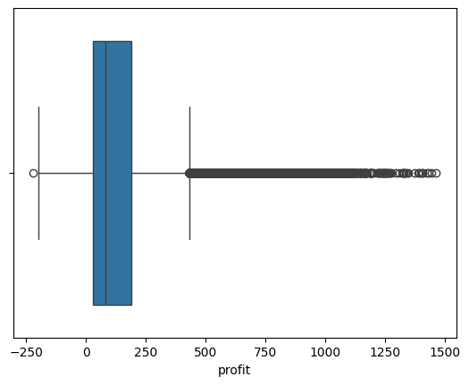
1463.96
1463.96
Outliers, missing values and Duplicates:
Before starting the comparison of the features and the hypothesis, I was able to check for the outliers. In this case, there are no outliers since there are no values that are below the minimum or above the maximum. The minimum value was -220.06, and maximum value was 1463.96.
Regarding the duplicates for all 4 datasets, there were no duplicates.
For the missing values, there was a missing values and they were replaced by 0.

Slide 6
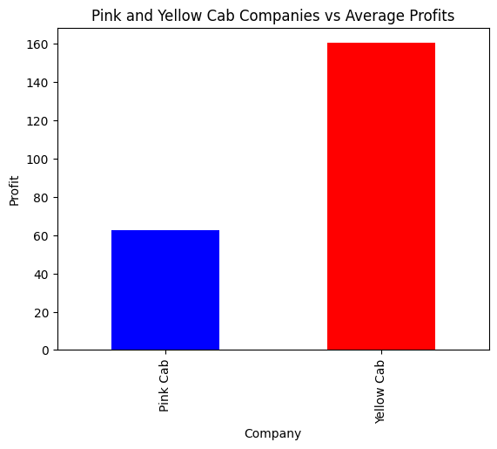
The bar chart for comparing the average profits for Yellow and Pink Cab
Hypothesis Result #1: As you can see above, the bar chart provides us average profits for two companies. The data indicates that the Yellow Cab’s profit is twice more than the pink cab, with a maximum average profit of $158, while Pink Cab is about $63. Due to its stronger profitability, the analysis implies that Yellow cab is a better option to invest than the Pink Cab.

Slide 7
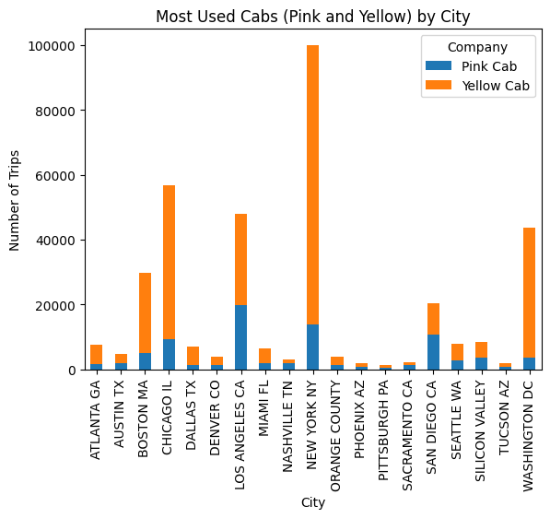
Stacked bar chart with the number of trips in different cities for both yellow and pink cabs
Hypothesis Result #2: In the stacked bar chart above, the most used cabs are the yellow cabs as in most of the cities, the number of users for yellow cab exceeds the pink cab users. For instance, in the city of Illinois, Chicago, the number of users for yellow cabs have approximately 43,000 trips, while pink users have 15,000 trips. This indicates that a yellow cabs are predominantly used over pink cabs in Illinois, as displayed in the bar chart below.

Slide 8
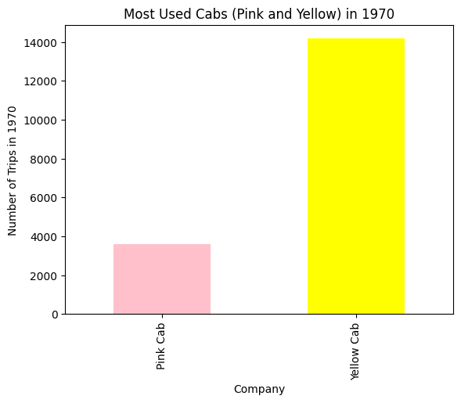
Bar chart comparison of number of trips in 1970
Hypothesis Result #3: The bar chart showcases the number of trips made by Yellow and Pink cabs in the year of 1970. As displayed below, the Yellow cab significantly had more trips made by consumers compared to the Pink Cabs. This suggest that there was a higher demand for Yellow Cabs during the year of 1970, and this data can be relevant for the XYZ firm in making a decision about investing it to Yellow Cab company.

Slide 9
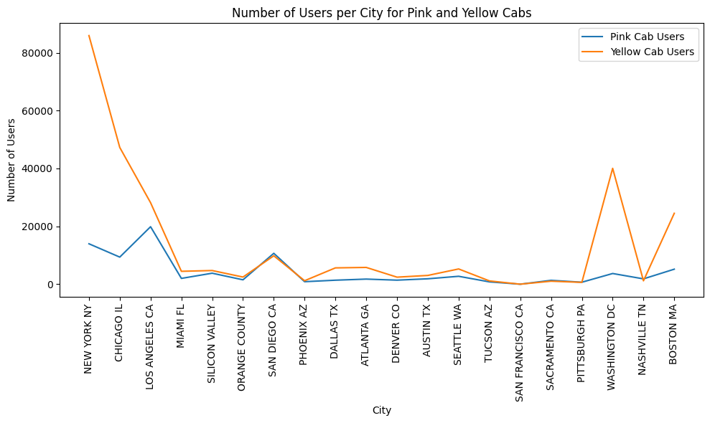
The line graph for the number of users in each city
Hypothesis Result #4: The line graph above displays the number of users for both Pink and Yellow Cabs used in different cities. Once again, in this graph, the graph depicts the most number of users in almost all the cities above is for Yellow Cabs. For instance, in Washington DC, the number of users for yellow cab is close to 40,000, while pink cab is only at approximately 12,000. In addition, this implies that a the difference in user numbers is significant, and this leads to the great potential to contributing to higher profitability.

Slide 10
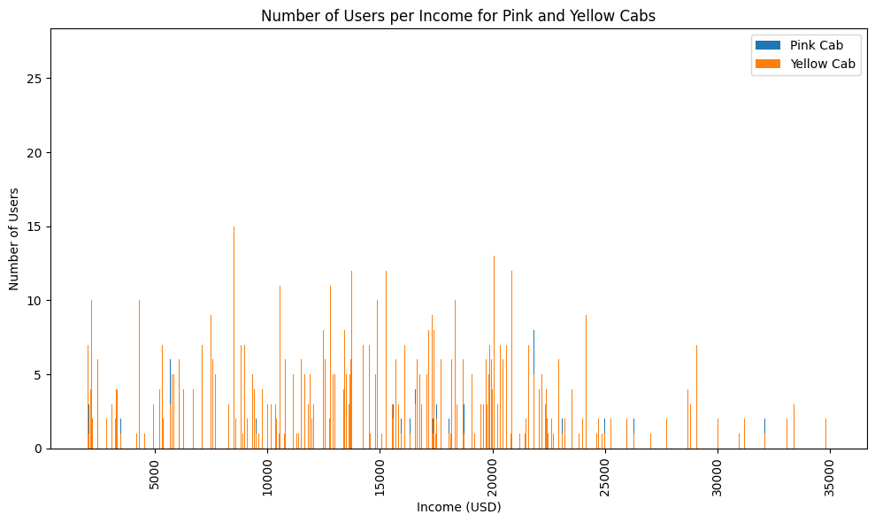
The bar chart for the number of users per income for Pink and Yellow Cabs
Hypothesis Result #5: The bar chart depicts the relationship between the customer income and usage of Pink and Yellow Cabs. It seems that with the different income levels, Yellow Cabs have a larger user base compared to the Pink Cab. It is noticeable that as the user’s income increases, the user count for Pink and Yellow Cab also increase, but the difference between the two companies seems pretty consistent across different income levels. This information will help the XYZ firm to make the investment decisions, which could be Yellow Cab.

Slide 11

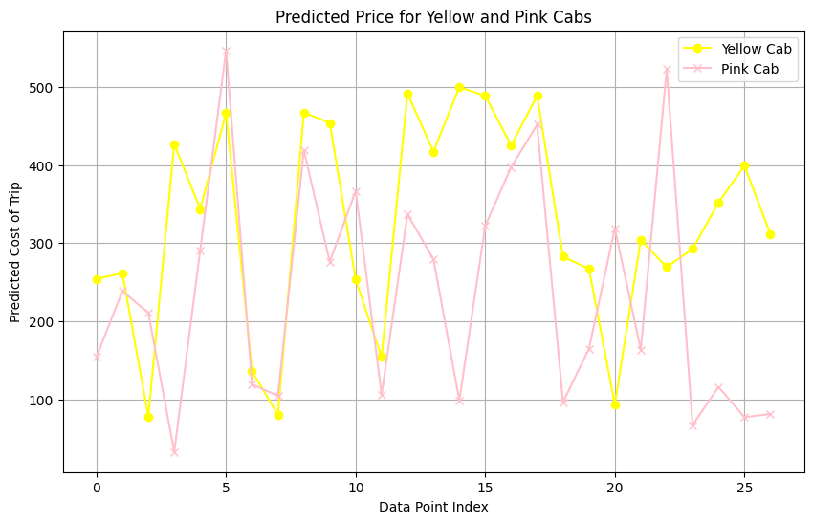
The linear graph for predicted prices for both Yellow and Pink Cabs
I made a prediction based on the predicted prices in the future for both Yellow and Pink Cabs. I used a linear regression model for predicting the prices, and it seems that the yellow cab will charge users more than the pink cab. There are particular parts in which the yellow cab prices are less than the pink cabs. For instance, at the data index point of 3, the price of Yellow cab will charge you approximately at $96, while Pink cab will be $201. To prove the XYZ firm that the Yellow cab is better to invest, I compared the mean absolute error for two cab companies.
The first means absolute error for Yellow Cab is 15.19, while Pink cab is 49.15. This means that Yellow Cab suggests a more accurate data.

Slide 12
1463.96
1463.96
EDA Summary:
The Exploratory Data Analysis reveals that Yellow Cab outperforms its competitors in profitability, showcasing the highest average profits among the cab companies analyzed. Additionally, it has a significantly larger user base, indicating a strong demand for its services. This combination of high profitability and substantial customer engagement positions Yellow Cab as a robust player in the cab industry. The analysis also highlights consistent performance trends that suggest Yellow Cab's operational efficiency and customer loyalty. Based on these findings, investing in Yellow Cab is a strategic decision for XYZ Firm, promising better returns and growth potential.

Slide 13
1463.96
1463.96
Recommendations:
Investing in Yellow Cab is a more advantageous option due to its superior profitability and larger user base compared to Pink Cab. This strong performance suggests that Yellow Cab has a well-established market presence and customer loyalty, which are critical factors for sustainable growth. By prioritizing this investment, XYZ Firm can capitalize on Yellow Cab's potential for increased market share, leading to greater profits in the long term. Additionally, supporting Yellow Cab in enhancing its marketing strategies and exploring expansion opportunities can further maximize returns on investment.

Slide 14

EDA For Cab Companies
Thank You

